Slide 1

CUTTING STOCK PROBLEM
WOOD CUTTING IN FURNITURE INDUSTRY
REL301m
Instructor: Nguyen An Khuong
GROUP 2 :
Nguyen Le Quoc Viet
Le Quoc Viet
Tran Huu Hoang
Nguyen Ngoc Phuc
Le Van Chuong
24 March 2025
© Copyright FPT Software – Level of Confidentiality

Slide 2

1
1
INTRODUCTION
2
HEURISTIC ALGORITHMS
CONTENT
3
APPLY REINFORCEMENT LEARNING
4
BENCHMARK
5
CONCLUSION

Slide 3
01. INTRODUCTION
© Copyright FPT Software – Level of Confidentiality

Slide 4

01. INTRODUCTION
1.1. The Cutting-Stock Problem
Cutting Stock Problem (CSP) is a classic optimization problem in the field of Operations Research. This problem arises from the need to cut large sheets of material (wood, metal, fabric, paper, etc.) into smaller pieces of specific sizes, in order to optimize material usage and minimize waste.
CSP comes in several variations: 1D, 2D, 3D — depending on the number of dimensions of the material to be cut.
1.2. What is Reinforcement Learning (RL)?
Reinforcement Learning (RL) is a branch of Machine Learning where an "agent" learns to act in an environment to optimize its "reward".
Reinforcement Learning is especially useful in sequential decision problems, where current actions can influence future states and outcomes.

Slide 5
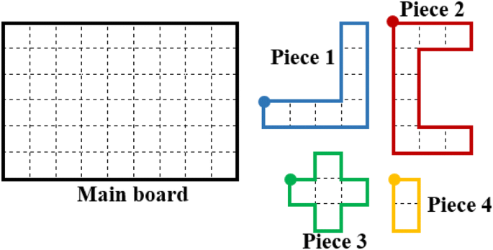
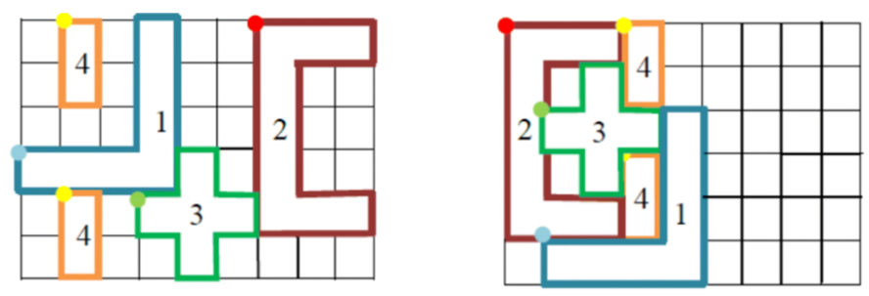
01. INTRODUCTION
1.3. Cutting Stock Problem In Reinforcement Learning
Traditionally, CSP is solved by methods such as Linear Programming, Heuristic,.... However, these methods have difficulty in problems with large state space, complex structure and high uncertainty.
However, these methods have difficulty in problems with large state space, complex structure and high uncertainty.
→ Reinforcement Learning emerges as a new approach to solving CSP with the following advantages:
Ability to learn from experience and improve over time.
Effectively handle problems with large and complex state spaces.
Can be applied to complex variants of CSP (2D, 3D).
2D Dim
A feasible solution
An optimal solution

Slide 6
02. ALGORITHMS
© Copyright FPT Software – Level of Confidentiality

Slide 7
02. ALGORITHMS
2.1. Heuristic Algorithms
2.1.1. What are Heuristic Algorithms?
Heuristic Algorithms are problem solving methods based on rules of thumb and intuition to find approximate solutions.
These algorithms are especially useful when finding the exact optimal solution is not feasible or is computationally expensive.
The main goal of a heuristic is to find a good enough solution in a reasonable amount of time, rather than trying to find the absolute optimal solution.
2.1.2. Heuristics in Cutting Stock Problem (CSP)
In the Cutting Stock Problem, heuristics play an important role in finding feasible cutting options, minimizing material waste and saving costs.
Heuristic algorithms often incorporate specific constraints such as limited number of cuts, guillotine cutting style (straight cutting) to minimize the search space and process faster.
Although they do not guarantee global optimization, these algorithms are often effective in practice when making quick decisions and optimizing resources.

Slide 8

02. ALGORITHMS
2.2. Applying Heuristic Algorithms in CSP
Three popular Heuristics methods in CSP include:
First-Fit Algorithm: Place each item in the first available location that can accommodate it without violating the constraints. This method is simple, fast, and often used as a basis for comparison, but does not guarantee finding the global optimal solution.
Best-Fit Algorithm: Place the item in the location with the smallest available space but enough to accommodate it, helping to optimize space and reduce material waste. Although more effective than First-Fit in many cases, it requires more checks and may still miss the optimal solution.
Greedy Algorithm: Always choose the best cutting option at the current time in the hope of achieving the global optimum. This method is fast, easy to implement, and effective in practice, but is prone to local extremes and does not guarantee the global optimum.

Slide 9
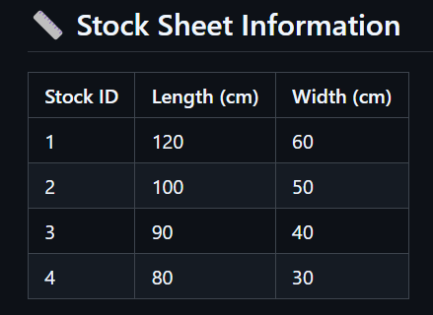
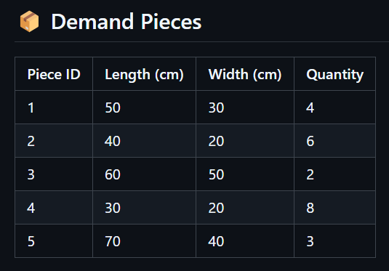
02. ALGORITHMS
2.2. Applying Heuristic Algorithms in CSP
2.2.1. First Fit Algorithm
Cutting Data

Slide 10
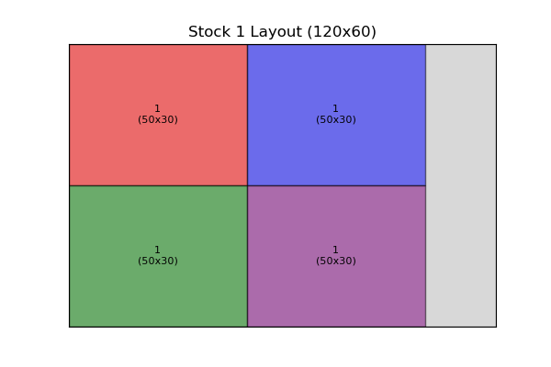
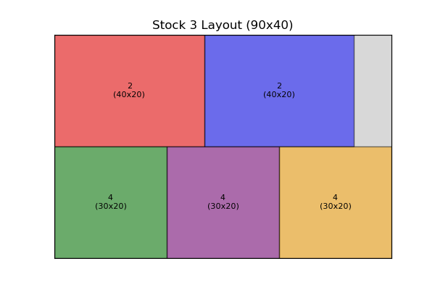
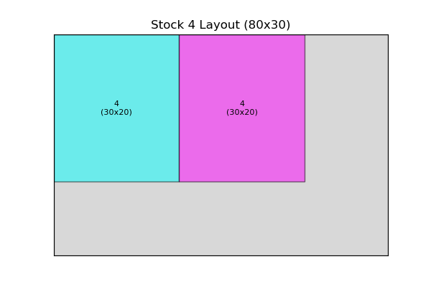
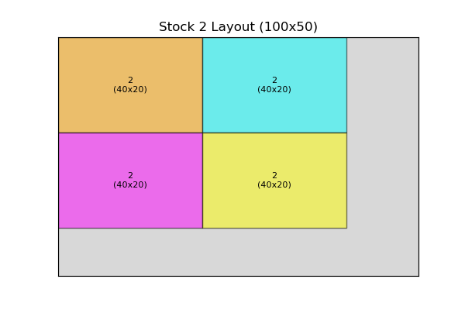
02. ALGORITHMS
2.2. Applying Heuristic Algorithms in CSP
2.2.1. First Fit Algorithm
After applying the First Fit approach, the stock sheets are used as follows:

Slide 11
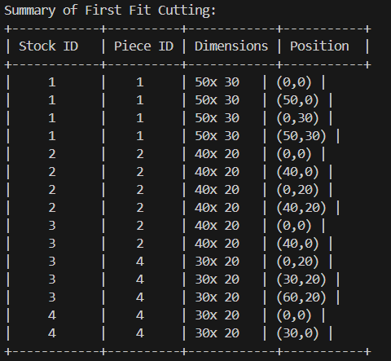
02. ALGORITHMS
2.2. Applying Heuristic Algorithms in CSP
2.2.1. First Fit Algorithm
After applying the First Fit approach, the stock sheets are used as follows:
📋 Summary Table
This table provides a breakdown of how the pieces were placed on the stock sheets using the First Fit approach. Each row represents a piece that was successfully placed, detailing the stock sheet it was placed on, the dimensions of the piece, and its position on the stock sheet.

Slide 12
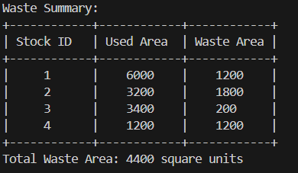
02. ALGORITHMS
2.2. Applying Heuristic Algorithms in CSP
2.2.1. First Fit Algorithm
After applying the First Fit approach, the stock sheets are used as follows:
🚮 Waste Summary
Total Area = Stock Length × Stock Width
Used Area = Sum of all placed pieces' areas
Waste Area = Total Area - Used Area

Slide 13
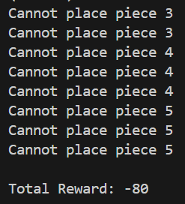
02. ALGORITHMS
2.2. Applying Heuristic Algorithms in CSP
2.2.1. First Fit Algorithm
After applying the First Fit approach, the stock sheets are used as follows:
🎯 Reward System
To assess the efficiency of the cutting strategy, a reward system is introduced:
Penalty of -10 points for each piece that could not be placed.
The final reward score helps evaluate the effectiveness of the approach.

Slide 14
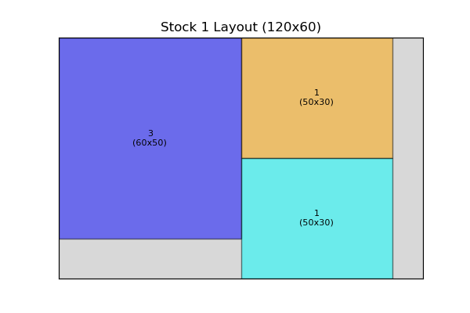
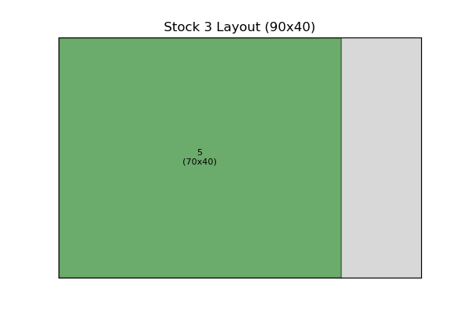
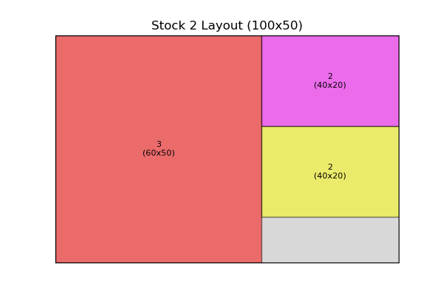
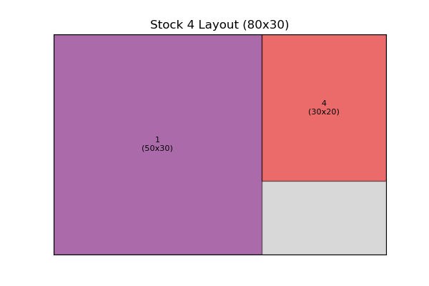
02. ALGORITHMS
2.2. Applying Heuristic Algorithms in CSP
2.2.2. Best Fit Algorithm
After applying the Best Fit approach, the stock sheets are used as follows:

Slide 15
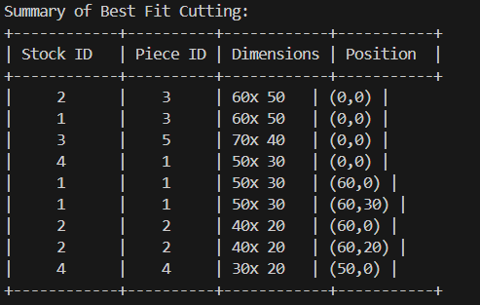
02. ALGORITHMS
2.2. Applying Heuristic Algorithms in CSP
2.2.2. Best Fit Algorithm
After applying the Best Fit approach, the stock sheets are used as follows:
📋 Summary Table
This table provides a breakdown of how the pieces were placed on the stock sheets using the Best Fit approach. Each row represents a piece that was successfully placed, detailing the stock sheet it was placed on, the dimensions of the piece, and its position on the stock sheet.

Slide 16
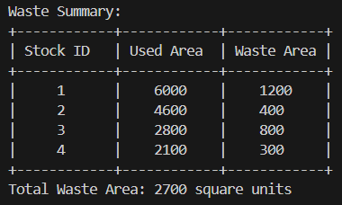
02. ALGORITHMS
2.2. Applying Heuristic Algorithms in CSP
2.2.2. Best Fit Algorithm
After applying the Best Fit approach, the stock sheets are used as follows:
🚮 Waste Summary
Total Area = Stock Length × Stock Width
Used Area = Sum of all placed pieces' areas
Waste Area = Total Area - Used Area

Slide 17
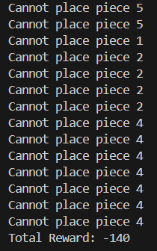
02. ALGORITHMS
2.2. Applying Heuristic Algorithms in CSP
2.2.2. Best Fit Algorithm
After applying the Best Fit approach, the stock sheets are used as follows:
🎯 Reward System
To assess the efficiency of the cutting strategy, a reward system is introduced:
Penalty of -10 points for each piece that could not be placed.
The final reward score helps evaluate the effectiveness of the approach.

Slide 18
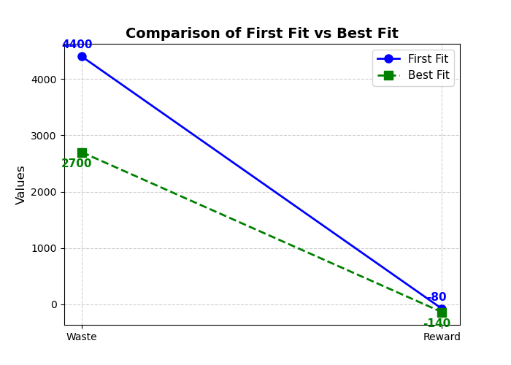
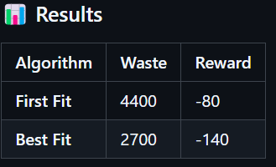
02. ALGORITHMS
2.2. Applying Heuristic Algorithms in CSP
2.2.3. Comparison of First Fit vs Best Fit
📝 Observations
If the goal is to minimize material waste, Best Fit performs better.
If balancing efficiency and penalty is important, First Fit is a better option.
→ Implementing Reinforcement Learning to find an optimized cutting strategy.

Slide 19
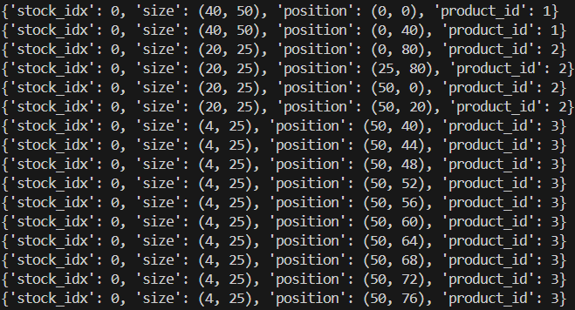
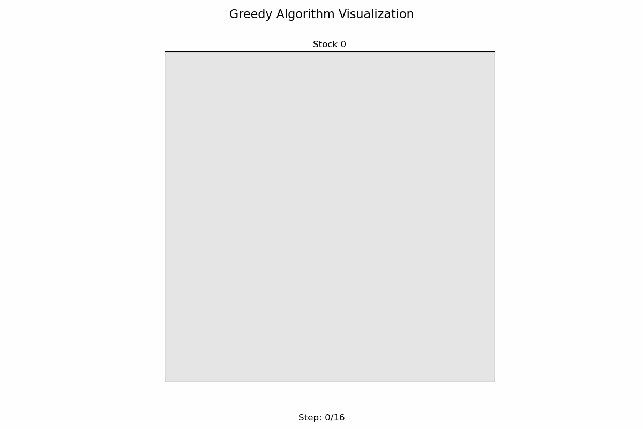
02. ALGORITHMS
2.2. Applying Heuristic Algorithms in CSP
2.2.4. Greedy Algorithm
📋 Summary Table
- Place the product in the first stock with enough free space.
- If there is no suitable stock, create a new stock.
- Prioritize placing large products first to optimize space.

Slide 20
02. ALGORITHMS
2.2. Applying Heuristic Algorithms in CSP
2.2.4. Greedy Algorithm
Function Greedy_2DCSP:
Sort stock_list from largest to smallest area
Sort product_list from largest to smallest area
for stock_i in stock_list:
for product_j in product_list:
for (x, y) in all possible positions on stock_i:
if product_j can be cut at (x, y):
let S_ij be the area of the smallest rectangle containing the cut area
let (x0, y0) be the position where S_ij is minimized
Cut product_j from stock_i at (x0, y0)
for stock_i in left over_stock_list:
for stock_j in uncut_stock_list:
if leftover area of stock_i is smaller than stock_j:
Move cut set of stock_i to stock_j
The greedy algorithm operates as follows:
Product and Stock Selection:
Products and stock sheets are sorted based on area, with larger areas prioritized to maximize utilization of larger sheets.
Position Evaluation:
For each stock sheet, the algorithm attempts to place each product in all feasible positions where it can fit.
Among all possible positions, the algorithm selects the one where the total cut area is minimized to preserve as much stock area as possible.
Placement Decision:
Once the optimal position is found, the product is cut from the stock sheet at that position.
If a product cannot fit on any existing stock sheet, a new stock sheet is introduced.
Stock Optimization:
After cutting, smaller leftover stock sheets are merged with larger uncut stock sheets when possible to optimize space usage.

Slide 21
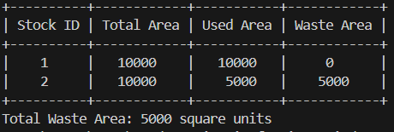
02. ALGORITHMS
2.2. Applying Heuristic Algorithms in CSP
2.2.2. Greedy Algorithm
🚮 Waste Summary
Total Area = Stock Length × Stock Width
Used Area = Sum of all placed pieces' areas
Waste Area = Total Area - Used Area
Fitness = 1 - Total Waste Area / Used Area

Slide 22
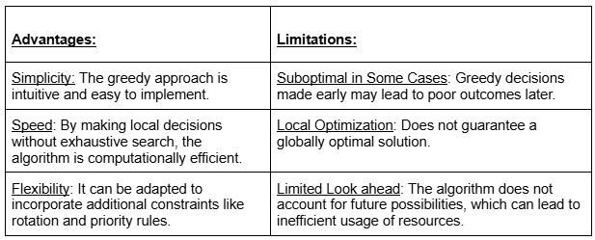
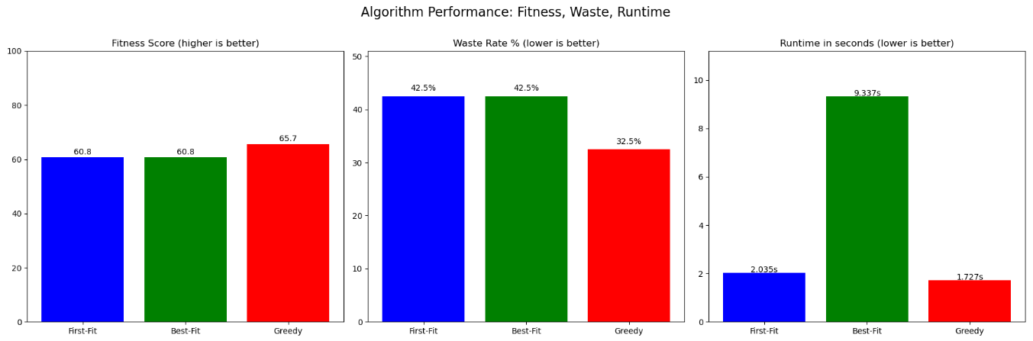
02. ALGORITHMS
2.2. Applying Heuristic Algorithms in CSP
2.2.2. Greedy Algorithm

Slide 23
03. APPLY REINFORCEMENT LEARNING
© Copyright FPT Software – Level of Confidentiality

Slide 24
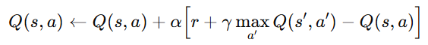
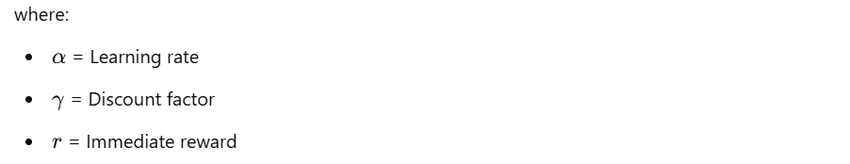
03. APPLY REINFORCEMENT LEARNING
3.1. Q-Learning
3.1.1 What is Q-learning?
Q-learning is a popular reinforcement learning algorithm that allows an agent to learn how to make optimal decisions in an environment by trying and learning from the actions it takes.
Q-learning updated by formula:
State: Current configuration of the wood sheet.
Action: Choosing a piece and placing it at a specific location.
Reward: Based on material utilization (higher rewards for efficient placements).

Slide 25
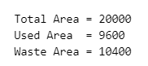
03. APPLY REINFORCEMENT LEARNING
3.1. Q-Learning
3.1.2 Application of Q-learning in Cutting Stock problem
Q-learning helps learn effective cutting strategies by interacting with the environment to minimize material waste and reduce stock usage.
It improves decisions over time by updating a Q-table based on cutting outcomes in different states.
By incorporating constraints like guillotine cuts, edge placement, and non-overlapping rules, it focuses on feasible actions.
Though not globally optimal, Q-learning is practical for finding near-optimal solutions and adapting to dynamic cutting scenarios.
Different sized pieces (20×25, 40×75, 4×25,...) are placed in suitable positions to optimize the usable area.
The algorithm finds the appropriate position to minimize waste.

Slide 26
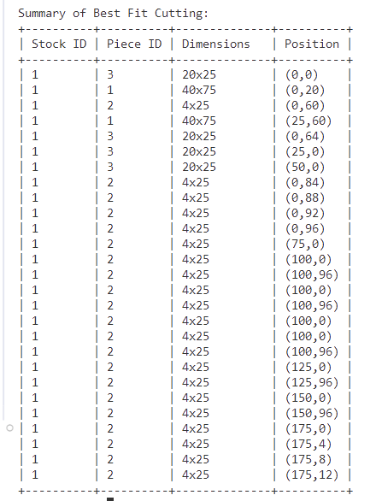
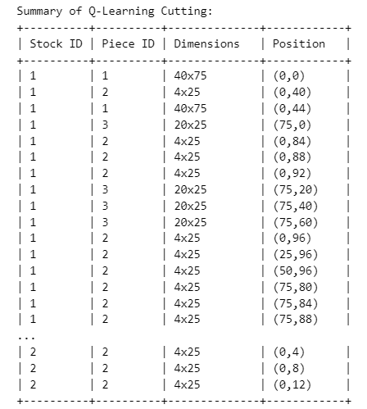
03. APPLY REINFORCEMENT LEARNING
3.1.Q-Learning
3.1.3 Summary results

Slide 27
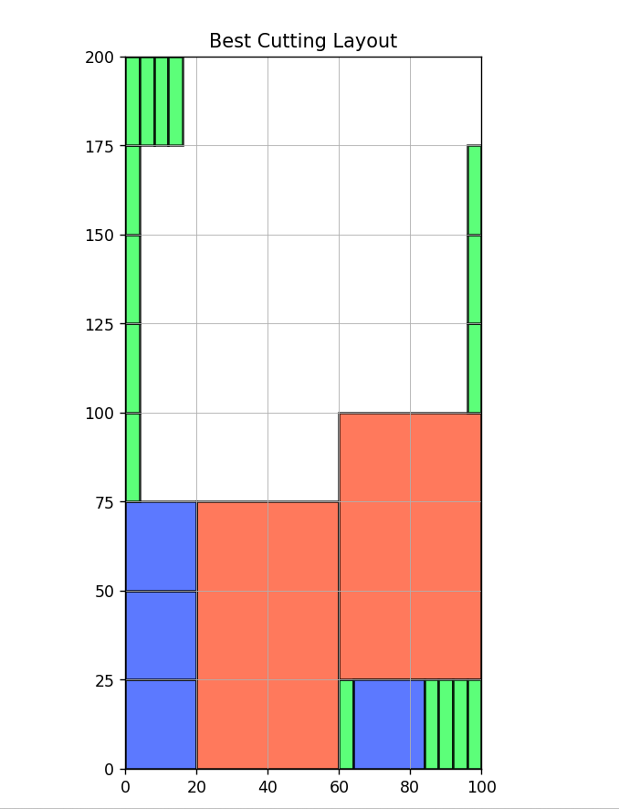
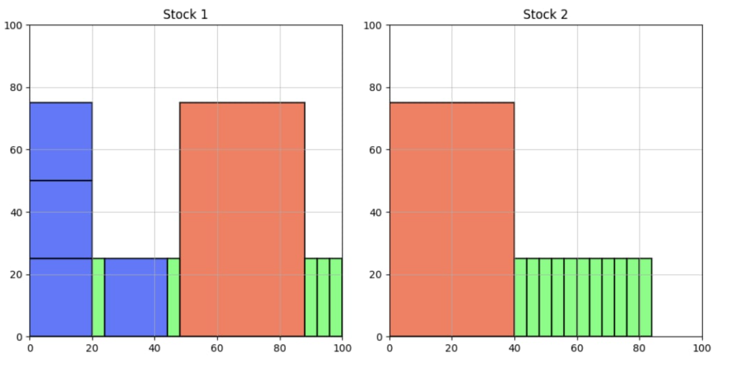
03. APPLY REINFORCEMENT LEARNING
3.1.Q-Learning
3.1.4. Visualization results
The pieces are packed tightly to optimize the usable area.
Some small gaps appear, indicating wasted material.
The algorithm has found the most optimal layout within the allowed range.
X-axis and Y-axis: Represent the size of the raw material sheet.
Different colored rectangles: Represent the cut pieces.
Red: Table
Blue: Chair
Green: Leg

Slide 28
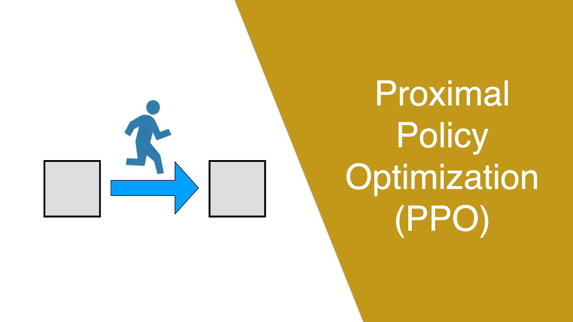
03. APPLY REINFORCEMENT LEARNING
3.2. PPO Approach to Training a RL Agent
Overview:
Proximal Policy Optimization (PPO) is a policy gradient method that balances exploration and exploitation by constraining policy updates.
PPO ensures stable and efficient learning.
Actor-Critic architecture: The actor learns the policy, and the critic estimates the value function.
How PPO Works:
Agent-Environment Interaction: The agent executes actions in a series of episodes.
Policy Representation: The policy is represented by a neural network, where θ denotes the network’s parameters.
Training Process:
Two neural networks: Actor (outputs action probabilities) and Critic (estimates state value).
The goal: Optimize the policy to maximize the expected discounted sum of rewards.

Slide 29
03. APPLY REINFORCEMENT LEARNING
3.2. PPO Approach to Training a RL Agent
Network Architecture & Action Selection
Actor-Critic Network Architecture:
Grid, order, and platform index processed using Convolutional Neural Network (CNN).
The actor outputs logits for the four action components (x, y, piece type, rotation), which are then converted into probability distributions using a softmax function.
Rotation fixed at 0, as items are non-rotatable.
Action Selection & Masking:
Masking invalid pieces (those with zero remaining quantity) by setting their logits to negative infinity, ensuring only valid pieces are selected.
Action probabilities are sampled from categorical distributions for each component.
Total action log probability is the sum of individual log probabilities.

Slide 30
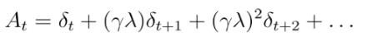
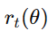
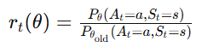
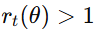
03. APPLY REINFORCEMENT LEARNING
3.2. PPO Approach to Training a RL Agent
Advantage Function & Probability Ratio
Advantage Function:
Advantage (A): Measures the value of an action relative to the expected state value:
A=Q−V
If A > 0, the action yields a better return than average.
We use Generalized Advantage Estimation (GAE) to compute advantages and reduce variance by incorporating a discount factor γ and GAE parameter λ.
Probability Ratio:
The ratio compares the new policy to the old policy for an action in state s.
f
fd
Interpretation: If , the action is more likely under the new policy; if it's less likely.

Slide 31
03. APPLY REINFORCEMENT LEARNING
3.2. PPO Approach to Training a RL Agent
Objective Function & Training Process
Objective Function:
The PPO objective function balances policy improvement and stability:
fd
The clip function prevents large policy updates that could destabilize training.
Total loss: Combines actor loss, critic loss, and an entropy term to encourage exploration.
Training Process:
The agent interacts with the environment, storing states, actions, and rewards.
The memory is divided into mini-batches and updated using the Adam optimizer.
Advantages are normalized to reduce variance, and the total loss is minimized during training.

Slide 32
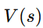
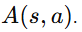
03. APPLY REINFORCEMENT LEARNING
3.3. Deep Q-Network Approach to Training a RL Agent
Overview:
Deep Q-Network (DQN) is a value-based RL method that approximates the action-value function (Q-function) using a neural network.
The goal: maximize expected cumulative reward by selecting optimal actions.
Alternative to PPO for the wood-cutting problem.
DQN Network Architecture:
Network Design:
Convolutional Neural Network (CNN) processes the grid.
Fully connected layers incorporate the order and platform index.
Dueling Architecture:
Splits the output into a state-value stream and advantage stream
ff
Benefits of Dueling Architecture:
Improves learning by separately estimating state value and action advantage.
Q-value output is a tensor representing all possible actions.

Slide 33
03. APPLY REINFORCEMENT LEARNING
3.3. Deep Q-Network Approach to Training a RL Agent
Action Selection and Exploration
Exploration Strategy:
Uses an ε-greedy policy for exploration.
With probability ε, the agent selects a random action (ensuring the piece type has remaining quantity).
Otherwise, it selects the action with the highest Q-value.
Handling Invalid Actions:
Mask invalid piece types by setting Q-values to negative infinity for those actions.
Decay of ε:
ε decays from 1.0 to 0.01 over time to encourage exploitation as training progresses.

Slide 34
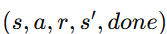
03. APPLY REINFORCEMENT LEARNING
3.3. Deep Q-Network Approach to Training a RL Agent
Experience Replay
Replay Buffer:
Stores transitions with a capacity of 10,000.
Mini-batches of size 64 are sampled randomly for training.
Reduces correlation between consecutive experiences and improves stability.
Target Network and Double DQN
Target Network:
Copied from the main Q-network to compute target Q-values.
Updated periodically by copying weights from the main network.
Double DQN:
Reduces overestimation bias by having the main network select actions and the target network evaluate Q-values.

Slide 35
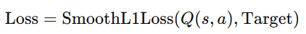
03. APPLY REINFORCEMENT LEARNING
3.3. Deep Q-Network Approach to Training a RL Agent
Loss Function and Optimization
Loss Calculation:
Huber loss (smooth L1 loss) between the predicted Q-value Q(s,a) and target Q-value.
Optimization:
Gradient clipping prevents exploding gradients.
Adam optimizer with a learning rate of 0.0001.
Training Process
Training Dynamics:
The agent collects experiences and stores them in the replay buffer.
The target network is updated every few steps to ensure stable Q-value estimates.
The reward structure encourages placing pieces efficiently and penalizes invalid actions.
The DQN approach learns to place pieces in the wood-cutting environment by balancing immediate rewards and long-term goals.

Slide 36
04. BENCHMARK
© Copyright FPT Software – Level of Confidentiality

Slide 37
04. BENCHMARK
4.1. Data to compare algorithms
We will benchmark with the same stock sheets and 4 orders with the following parameters.
"order_id": "order_001",
"stock_size": [100, 100],
"items": {
"table": { "size": [40, 50], "quantity": 2 }, // 2 * 2000 = 4000
"chair": { "size": [20, 25], "quantity": 4 }, // 4 * 500 = 2000
"leg": { "size": [4, 25], "quantity": 10 } // 10 * 100 = 1000
"order_id": "order_002",
"stock_size": [100, 100],
"items": {
"table": { "size": [40, 50], "quantity": 1 }, // 1 * 2000 = 2000
"chair": { "size": [20, 25], "quantity": 6 }, // 6 * 500 = 3000
"leg": { "size": [4, 25], "quantity": 20 } // 20 * 100 = 2000
"order_id": "order_003",
"stock_size": [100, 100],
"items": {
"table": { "size": [40, 50], "quantity": 3 }, // 3 * 2000 = 6000
"chair": { "size": [20, 25], "quantity": 6 }, // 6 * 500 = 3000
"leg": { "size": [4, 25], "quantity": 25 } // 25 * 100 = 2500
"order_id": "order_004",
"stock_size": [100, 100],
"items": {
"table": { "size": [40, 50], "quantity": 4 }, // 4 * 2000 = 8000
"chair": { "size": [20, 25], "quantity": 8 }, // 8 * 500 = 4000
"leg": { "size": [4, 25], "quantity": 30 } // 30 * 100 = 3000

Slide 38
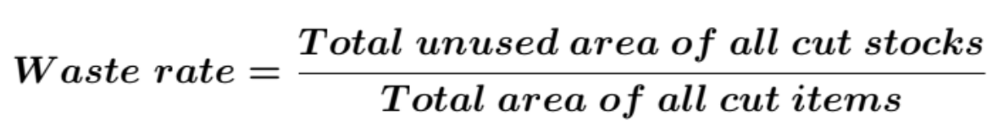
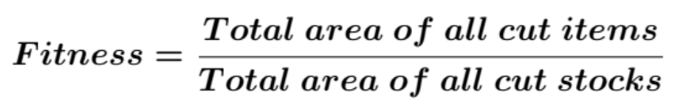
04. BENCHMARK
4.1. Data to compare algorithms
Our team will evaluate the algorithms on 3 criteria:
Waste Rate
Fitness
Runtime (s)

Slide 39
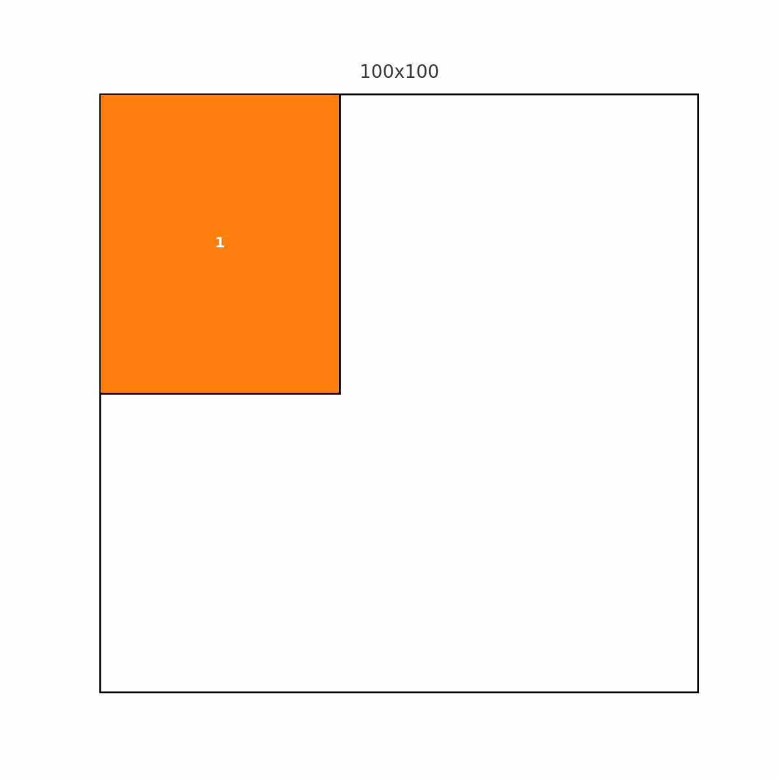
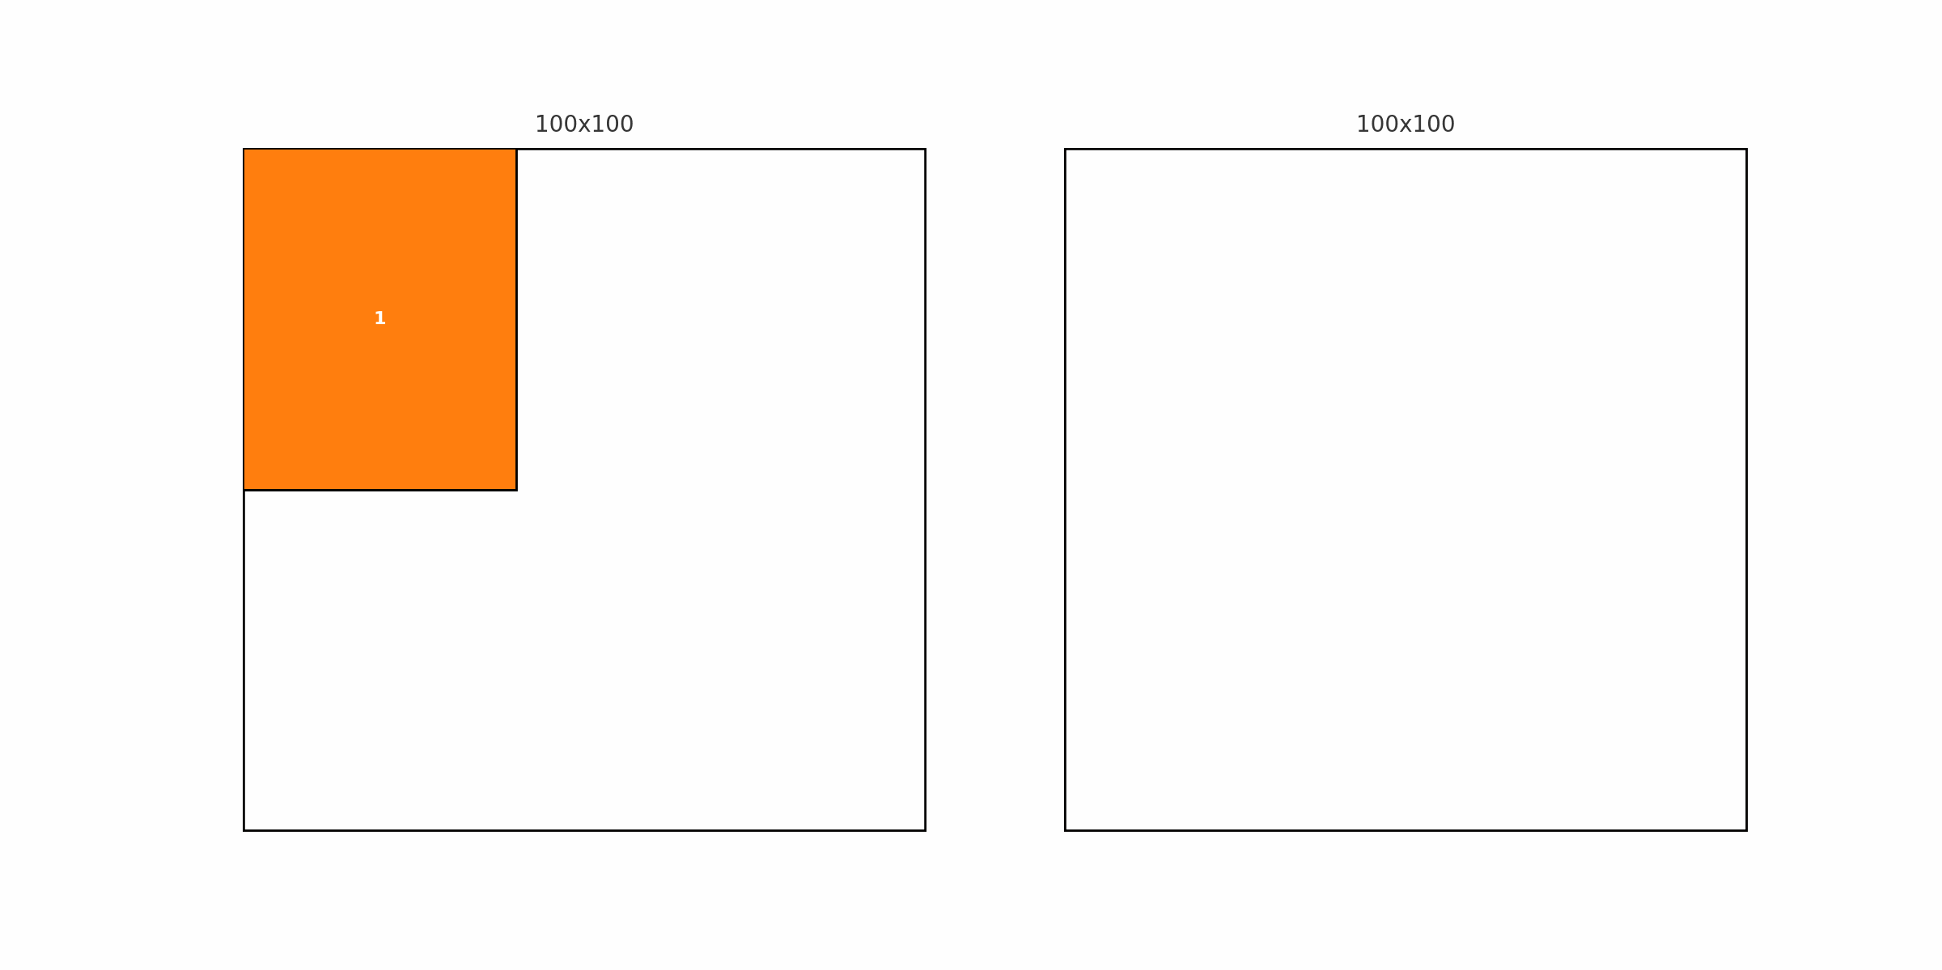
04. BENCHMARK
4.2. Combination Heuristic (First fit + Best fit)
Order 001
Order 003
Order 002
Order 004

Slide 40
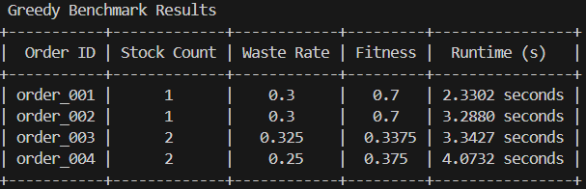
04. BENCHMARK
4.2. Combination Heuristic (First fit + Best fit)

Slide 41
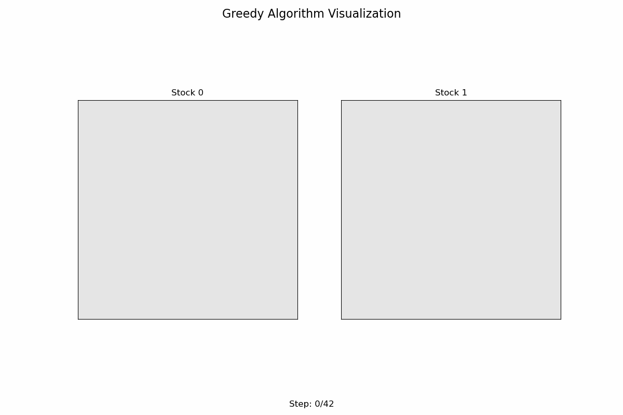
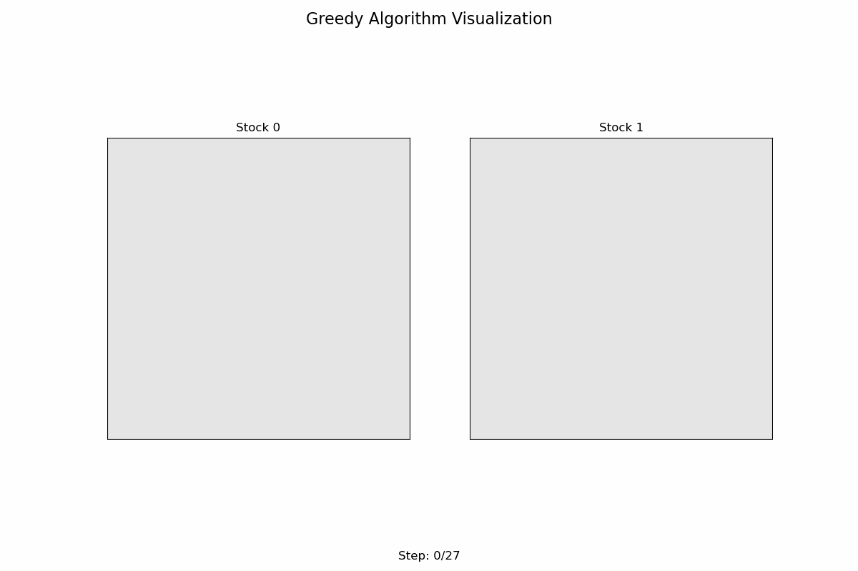
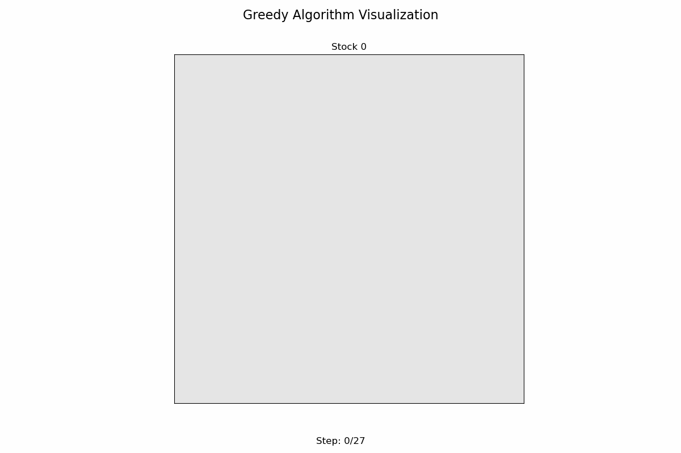
04. BENCHMARK
4.3. Greedy
Order 001
Order 003
Order 002
Order 004

Slide 42
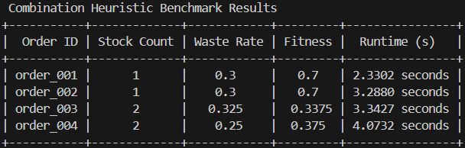
04. BENCHMARK
4.3. Greedy

Slide 43




04. BENCHMARK
4.4. Q-learning
Order 001
Order 003
Order 002
Order 004

Slide 44

04. BENCHMARK
4.4. Q-learning

Slide 45




04. BENCHMARK
4.5. Deep Q Network
Order 001
Order 003
Order 002
Order 004

Slide 46

04. BENCHMARK
4.5. Deep Q Network

Slide 47




04. BENCHMARK
4.6. PPO (Proximal Policy Optimization)
Order 001
Order 003
Order 002
Order 004

Slide 48

04. BENCHMARK
4.6. PPO (Proximal Policy Optimization)

Slide 49


04. BENCHMARK
4.7. Benchmark Overview
We evaluate and compare 5 cutting strategies across 4 different orders using key metrics:
Fitness Score, Waste Rate, and Runtime Performance.
Higher is better.
Q-Learning and Deep Q consistently maintain strong performance.
Lower is better.
Greedy algorithm shows instability with a high waste rate on complex orders.

Slide 50

04. BENCHMARK
4.8. Runtime Comparison
PPO and Deep Q exhibit higher runtime, while heuristic methods are fastest.
✅ Q-Learning achieves a good balance between cutting efficiency and resource utilization.
⚠️ Greedy methods are fast but less reliable on complex item combinations.
🔥 PPO and Deep Q achieve high precision but come with higher computational cost.

Slide 51
04. CONCLUSION
© Copyright FPT Software – Level of Confidentiality

Slide 52
04. CONCLUSION
In this big exercise, we have implemented three main algorithms for the 2D Cutting Stock Problem:
Heuristic Algorithm: Often incorporate specific constraints such as limited number of cuts, guillotine cutting style (straight cutting) to minimize the search space and process faster.
Q-learning: Helps learn effective cutting strategies by interacting with the environment to minimize material waste and reduce stock usage.
Deep Q-Network:
Maximize expected cumulative reward by selecting optimal actions.
Improves learning by separately estimating state value and action advantage
Proximal Policy Optimization (PPO): - Optimize sheet cutting so that waste is minimized and fitness is maximized.
Stability and Safety in Policy Updates
The Ability to Balance Exploration and Exploitation
The application of Q-learning in the 2D Cutting Stock Problem (CSP) demonstrates the potential of Reinforcement Learning (RL) in solving complex combinatorial optimization problems. While traditional heuristic methods such as First-Fit Decreasing (FFD), Best-Fit, and Greedy algorithms provide fast and relatively efficient solutions, Q-learning offers adaptability and the ability to learn from experience.

Slide 53

34

